Slide 1
Data Matters….
Because your work matters...
…but it is not visible to everyone.
Notes:
This can be seen as my TL;DR (too long; didn’t read) for the entire ppt! In other words , as we have increased linkages and impacts for DTC channels, we have to work even harder to make sure that new work is visible.

Slide 2
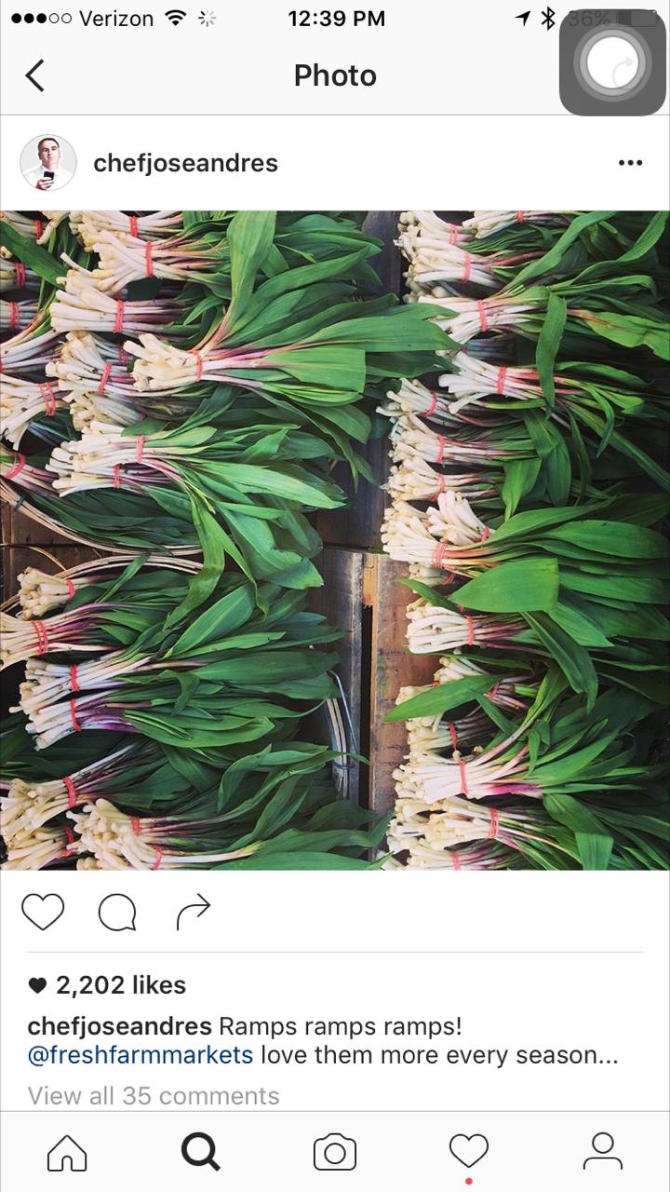
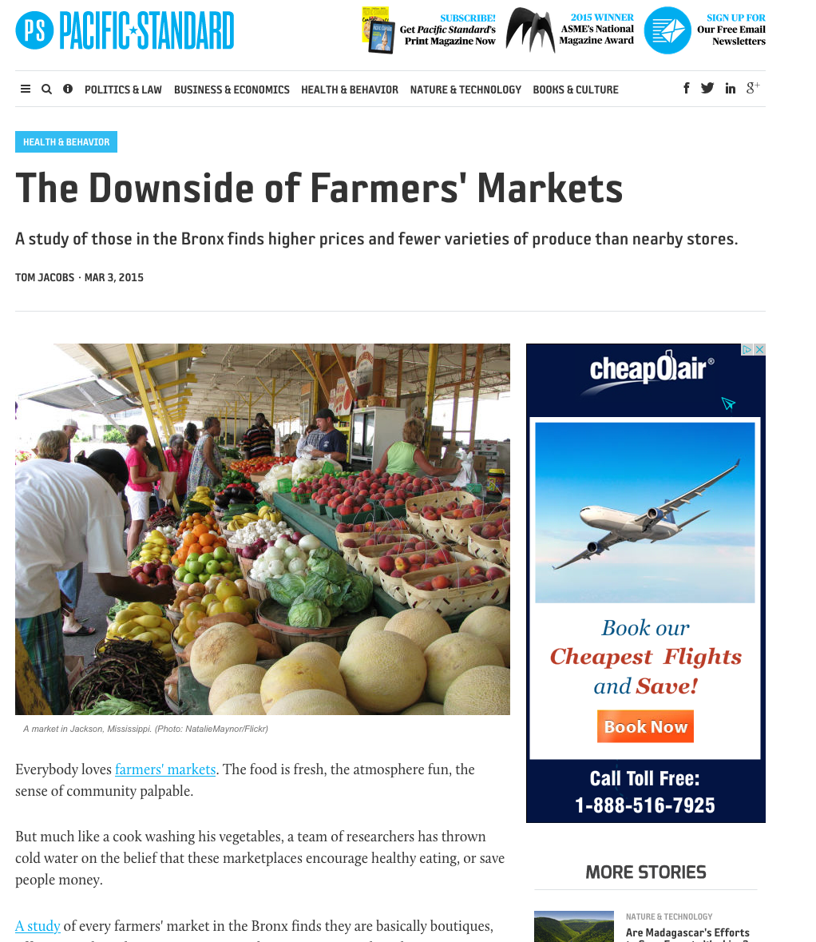
Data matters because….
Detractors
Promoters
Notes:
And when we think of who we should be talking to about those impacts and goals, those of us working on data think it is very important to think of it as a spectrum. If anyone is interested in digging down deep into this at your market org, FMC has a great exercise for you to do.

Slide 3
Potential and pressures are all around us.
Farmers markets & CSAs growth/decline/retooling
Market location instability
SNAP/vouchers/incentives programs are multiplying w/partners expecting more impact.
Increase in technology for food and farming
Corporate takeover of “local”
Rural places are losing population
Overall food shopping fragmentation and increased interest in
healthy food, and decreased loyalty to long-time brands
Notes:
When you consider the possibilities and barriers that are in front of us right now, it is so important to think across the spectrum in terms of audiences and partners.

Slide 4
Data matters because….
…producers are increasingly beset by offers from more outlets at which to sell their goods…
…with little data available to show how they will be a good partner for that business.
“The majority of producers selling at farmers markets utilized only direct market channels, including both direct-to-consumer and direct-to-retail channels. The next largest majority relied on an average of four market channels, including both wholesale and direct market channels.”
-2017 VT Farmers Market Report
Notes:
And for our vendors, there is no question that proactive channel partners are what they are hoping for to help them choose and refine their products . (How many market managers regularly talk to their vendors about their OTHER channels?)

Slide 5
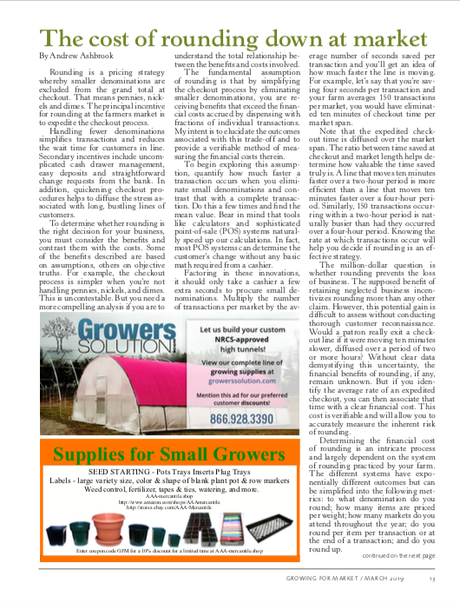
Reported reasons to sell at the market were as follows (ranked):
I have good relationships with the customers who attend;
It provides an opportunity for me to connect with new customers;
I make good money; I like the social atmosphere;
It’s close to my farm, work kitchen, or
place of business;
The market accepts SNAP EBT or other government food assistance benefits;
The market has high quality standards for locally produced food;
The market accepts credit and debit cards;
It’s easy to communicate with the market managers and staff.
STRENGTHENING PITTSBURGH’S FARMERS MARKETS, Report 2018 (FMC, City of Pittsburgh)
Notes:
What is interesting about this is that very often, it is the vendors who are already data-driven. I just attended 3 small farms conferences in the past 2 months, and the amount of data and technology that producers are using or considering using is impressive. If any of you read Growing For Markets, you see regular evidence of this. The article about rounding down is very detailed and really useful.
The other thing that often comes up when talking DTC or really any channel analysis is this idea that vendors are only using total sales as their rubric. This is am example of what farmers and other vendors told us during the report on farmers markets in Pgh that we just finished, and it is similar to other surveys I have seen on why our businesses choose certain outlets. Of course profit is a key indicator, but who wants t work somewhere they feel unwanted or unheard?

Slide 6
Data matters because….
Saturation?
Or stagnation?
Data will tell us which is which.
“I listen to people working on agricultural ideas talk about “food systems,” but I don’t know what they’re
referring to. We don’t have one. There is a system that’s highly dependent on poisons and petroleum.
And maybe some places have the beginnings of a small food system. But we’re not there yet.”
- Mary Berry, The Berry Center
Notes:
This came up this weekend with a story on NPR. Let me be clear: I’m not saying its NOT true; I’m just saying I don’t see enough data that says this is the factor that should be changed.

Slide 7
Data matters because….
“Why Markets Fail”
New markets were most vulnerable to failure with 24 percent closing during or after their first year of operation.
Other factors that increased risk of market failure, included:
Small number of vendors;
Need for a greater variety of farm products with specific emphasis on fruits and vegetables - products considered basic to farmers' markets;
Lack of administrative revenue to meet operating needs;
Low paid or volunteer market managers;
High manager turnover.
Oregon market survey 1990s
Notes:
This is the kind of data that I use on things like the NPR story to provide context.

Slide 8
“49% of the organizations saw an increase in the number of market vendors in 2018; only 15% had a decrease.
The rest stayed at the same level as the previous year.”
(FMC State of the Market Organization Survey 2018)
Notes:
Here’s some data. Now, the previous slide and this are not necessarily proving or disproving each other, but since 85% of the responses from our national survey saying that they stayed at the same number or increased their vendors, I’d like to understand more about where, and what the saturation is; is it at vendor level, or market level , or at the network level? Is it a clash between established and new markets?
One hypothesis I’d offer to be proven or disproven is that I think what vendors are saying when they say “too many markets” is that many markets in the same region have the exact same mission, the exact same product offerings, the exact same shoppers. If I were a vendor at two or more of them, I’d ask myself why I needed to deal with two different administrations, two different reimbursement systems and so on, if the return is simply split between the two.

Slide 9
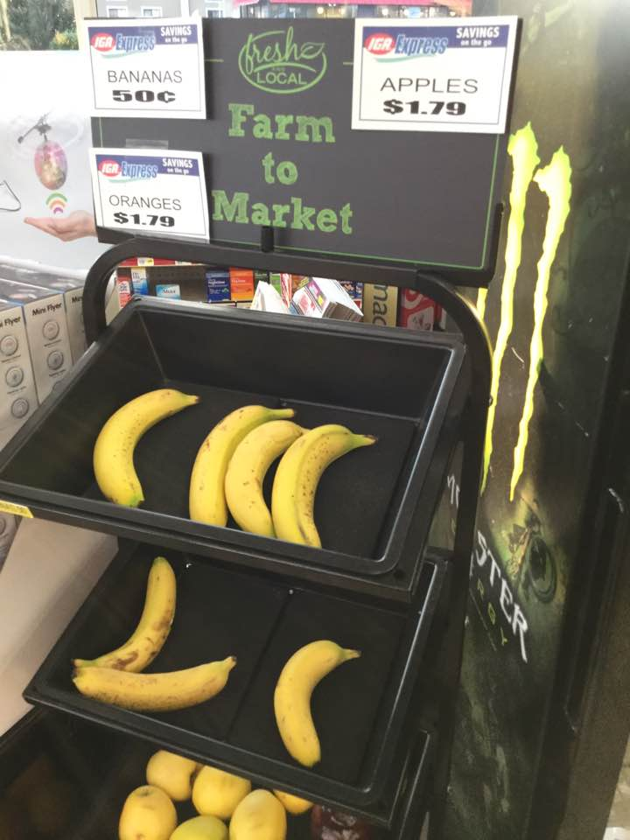
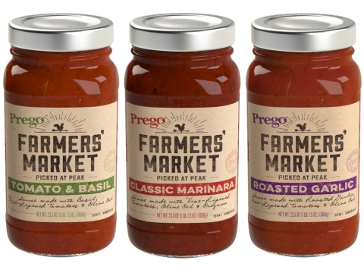
Data matters because….
“One of the weaknesses of our movement is bastardized language.
If you listen to ads from Wal-Mart and big chain grocery stores, they’ve got our
language.” (“Where Farmers Markets and CSAs Fall Short” An interview with Mary Berry)
Notes:
In terms of external pressures, this is the biggest right now. And we can help our own case with data and refinement of our message.

Slide 10
Data matters because….
“We have to be good citizens. And a way to be a good…citizen is to be an informed shopper and eater.” (Mary Berry)
Notes:
(I’d make this part of my message.)

Slide 11
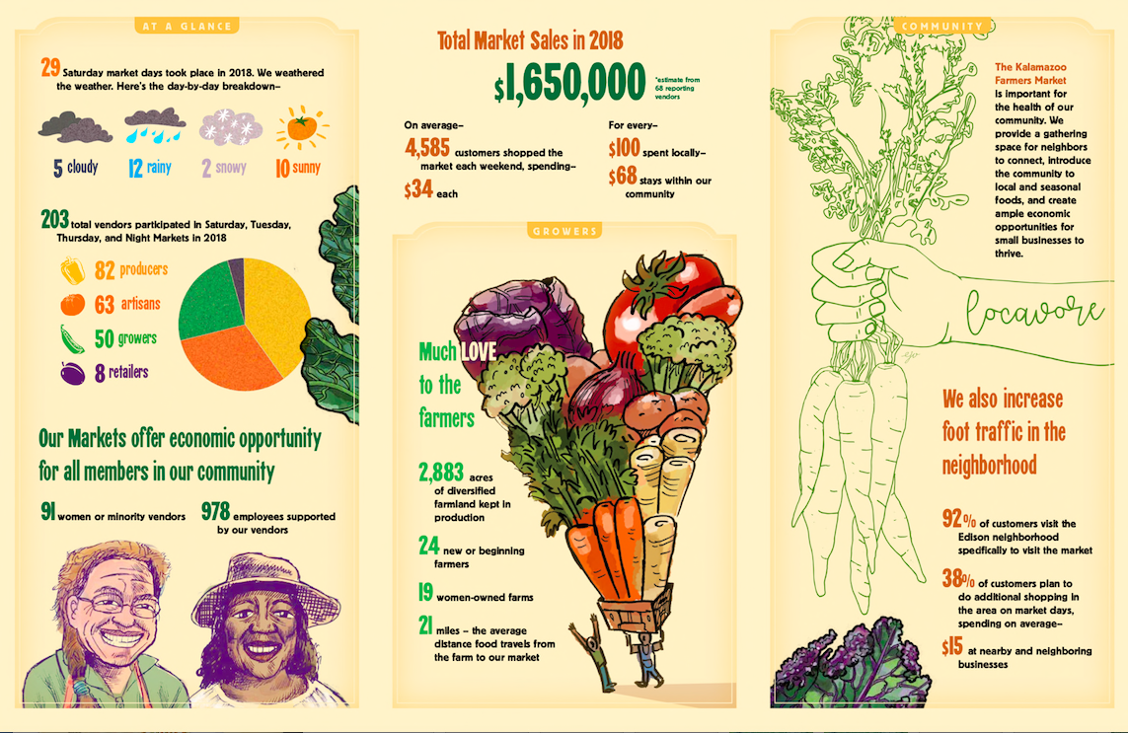
Data matters because…
…what works is “Story PLUS Data”
Notes:
If its just data, then how does the small market show how efficient it has been in attracting shoppers?
Or how to show multiple impacts in terms of an overall mission without story + data?
This has been a main focus for me over the past few years: raising up the market organization in the public eye in terms of food work. Just as the food hub or community garden is seen to be intentional and working on short and long term impacts, the market organization needs to do the same.

Slide 12
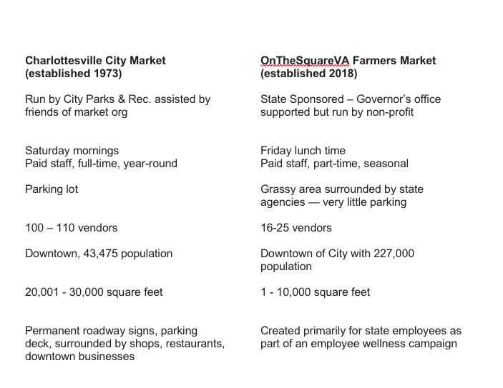
Notes:
If its just data, then how does the small market show how efficient it has been in attracting shoppers?
Or how to show multiple impacts in terms of an overall mission without story + data?
This has been a main focus for me over the past few years: raising up the market organization in the public eye in terms of food work. Just as the food hub or community garden is seen to be intentional and working on short and long term impacts, the market organization needs to do the same.

Slide 13
this work has been intentional, but often misunderstood:
Notes:
Another way to think of Story + Data is to think about the 8744. That is the number of markets the USDA currently lists I their directory and is considered the official number (and if your market isn’t on there, it isn’t counted.)
That’s a number but what is the story?

Slide 14
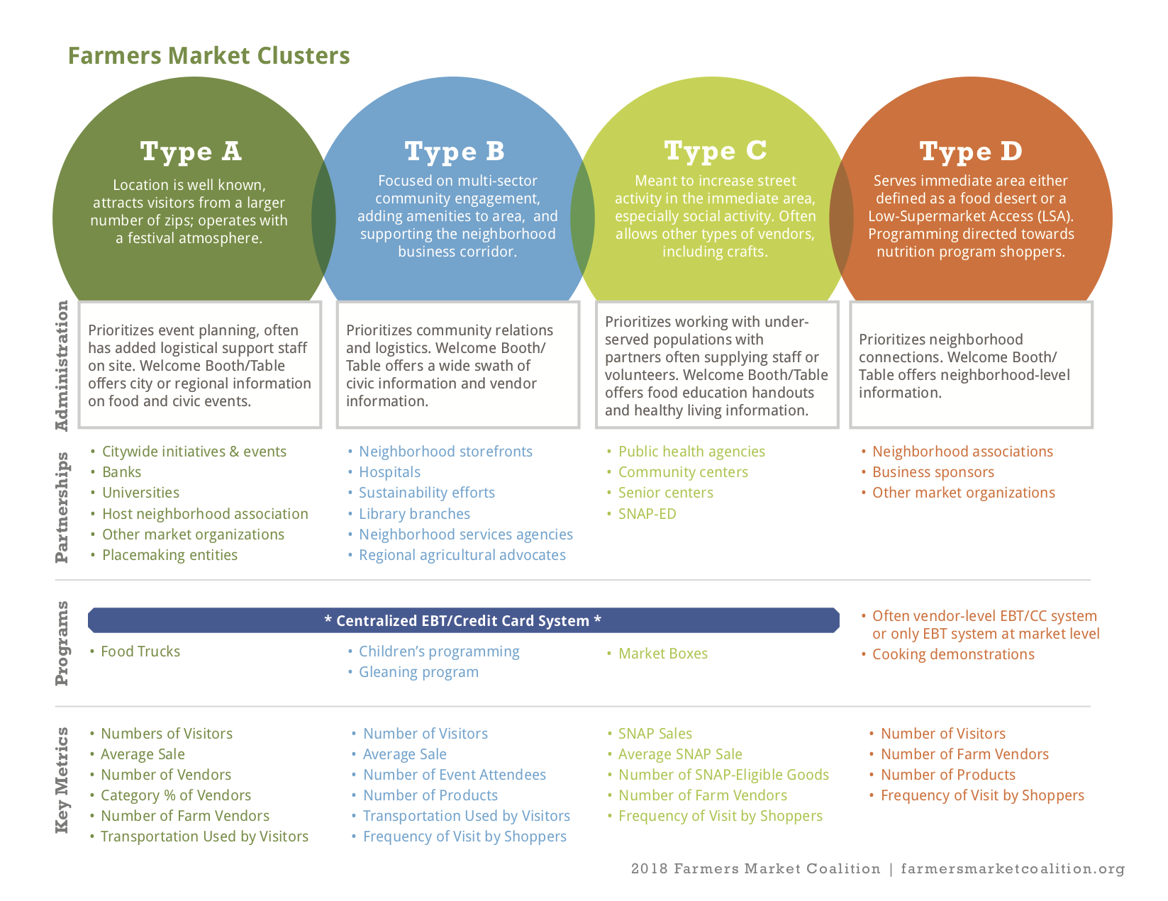
Notes:
This is from the Pgh work that FMC just finished for the City of Pgh. Because we know markets are not one-size-fits-all, we began this classification from the very start of the research to classify the 30 or so markets in the city. This has helped not only us, but the City and the markets themselves understand the local context.

Slide 15
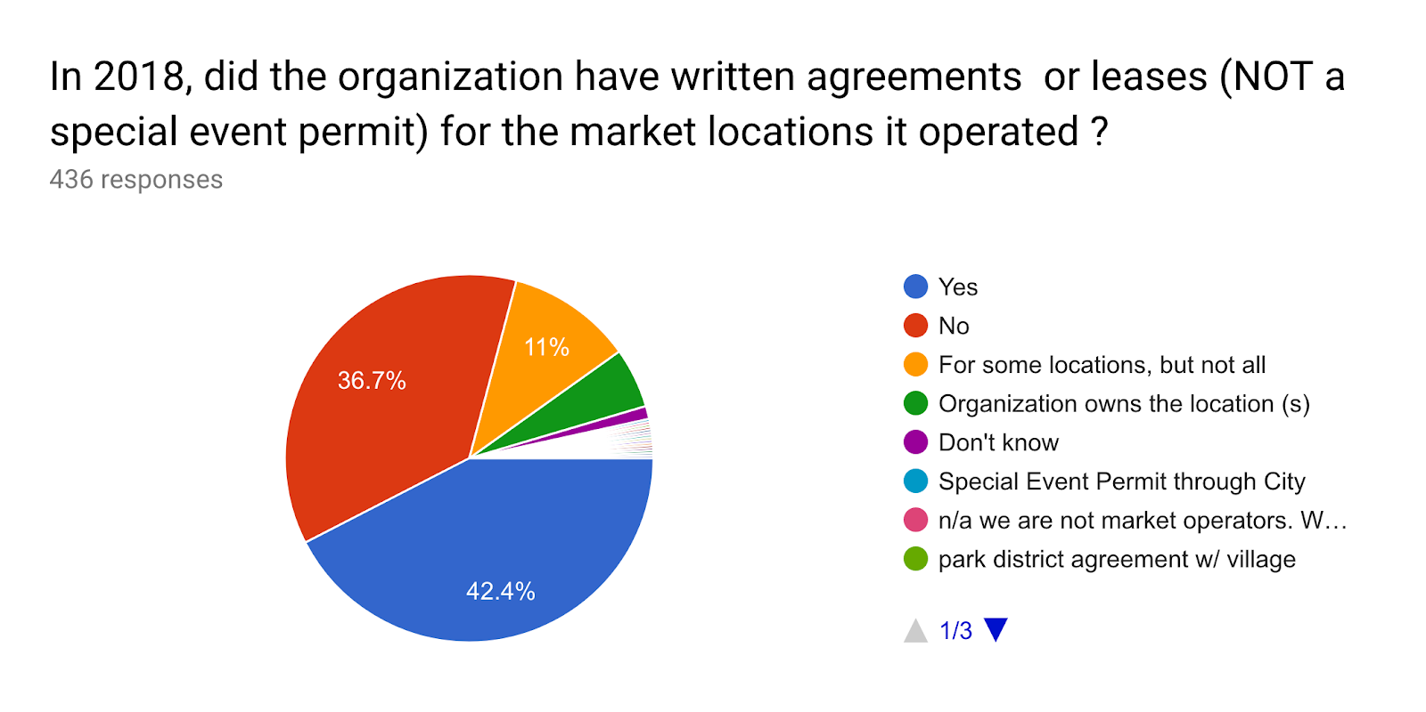
(FMC State of the Market Organization 2018)
Notes:
That kind of data may help us address issues like this, which is also data and also important to collect and share. The graphics and data points that NOFA-VT and VTFMA collect and show should be part of your reporting too.

Slide 16
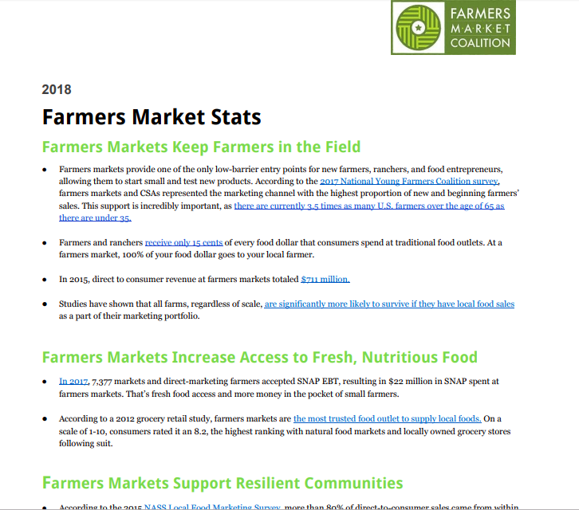
Data matters because….
“For markets open in both the 2012 and 2013 seasons, 64% reported increased customer traffic;
63% reported increases in their number of repeat customers; and 63% reported increases in annual sales.” USDA 2014
Notes:
When you put story + Data, you ca affect policy or create new streams of funding.
This is of course from NFMW which is growing in its reach and engagement every year. One thing we do at FMC leading up to it, is to collect and look at what data you are collecting and use it to create the story for that year.

Slide 17
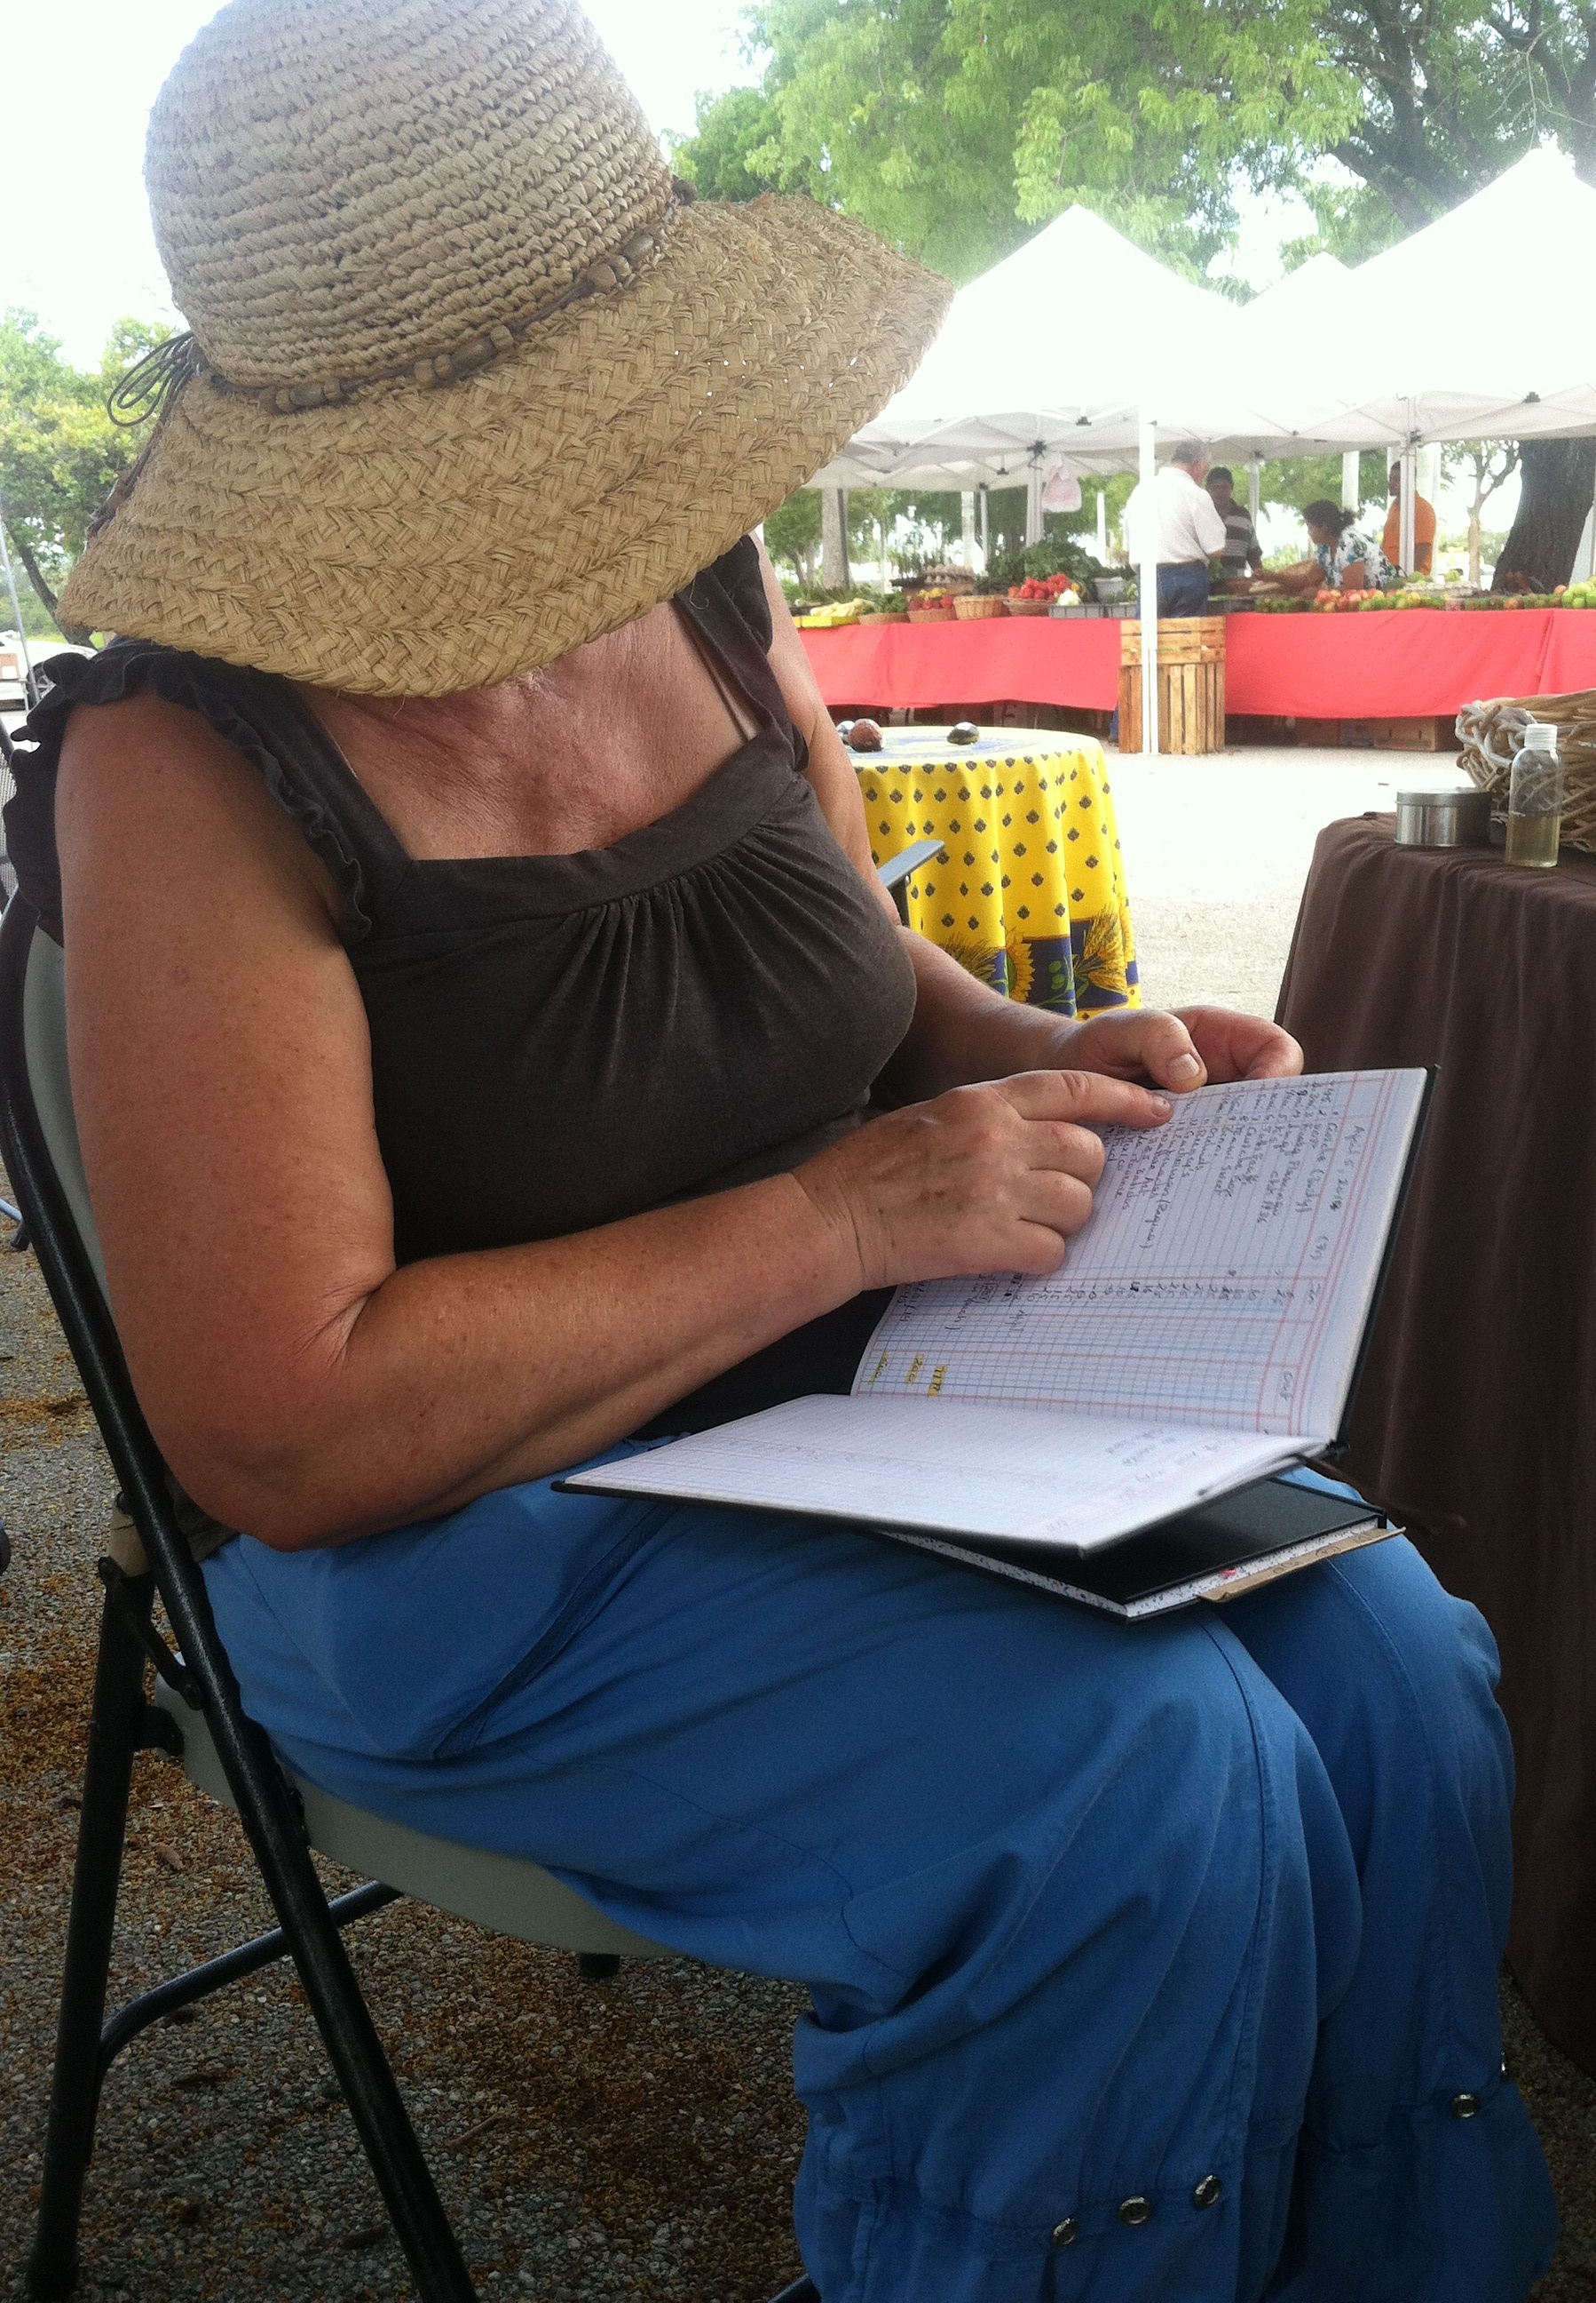
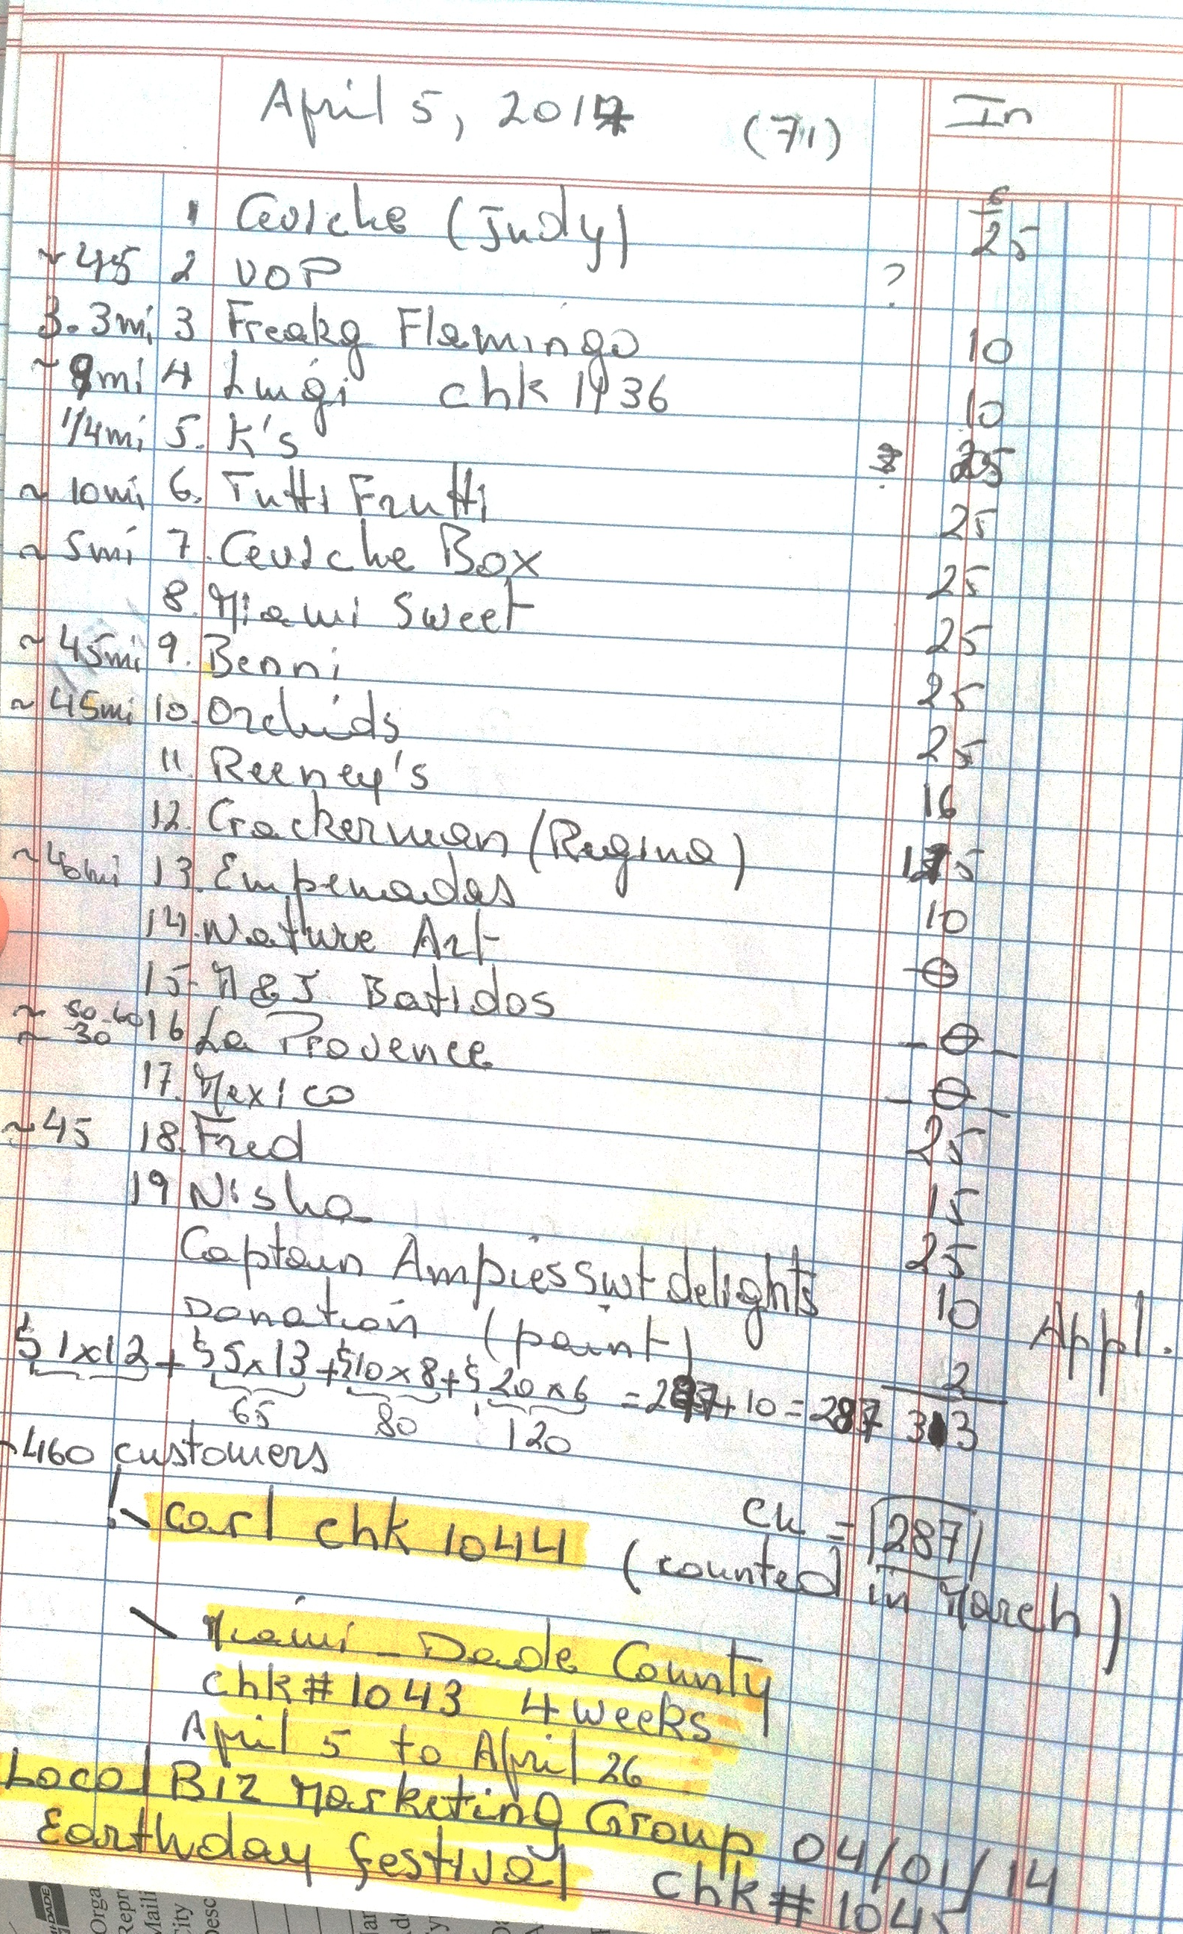
And you have it.

Slide 18
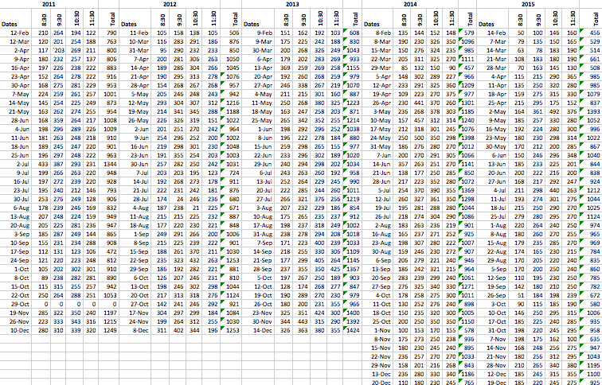
And you have it.

Slide 19
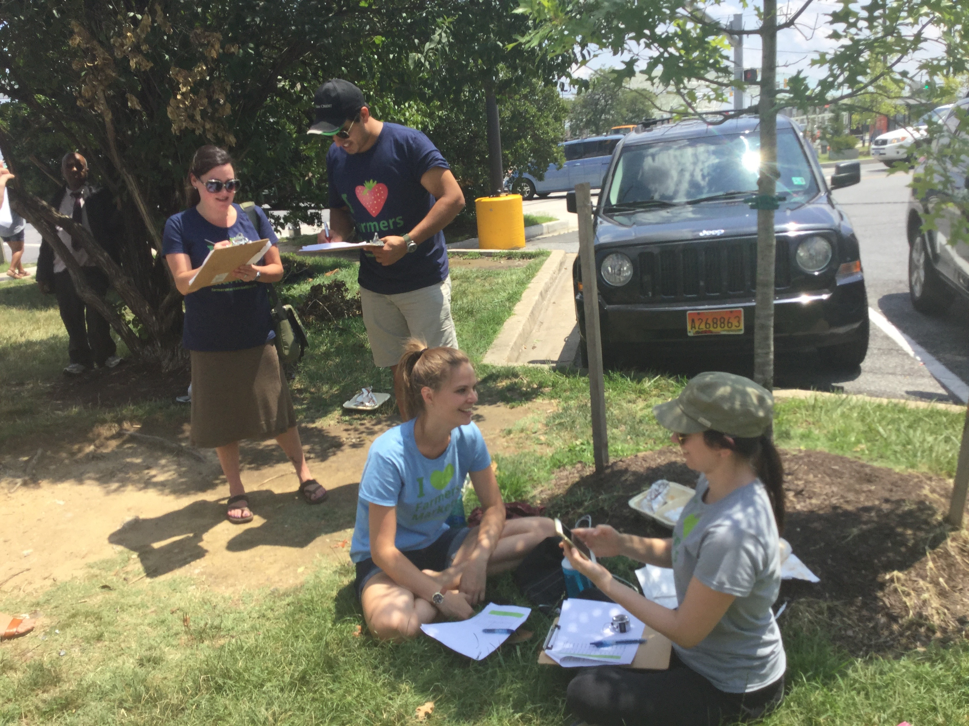
And can collect more with just a few people

Slide 20
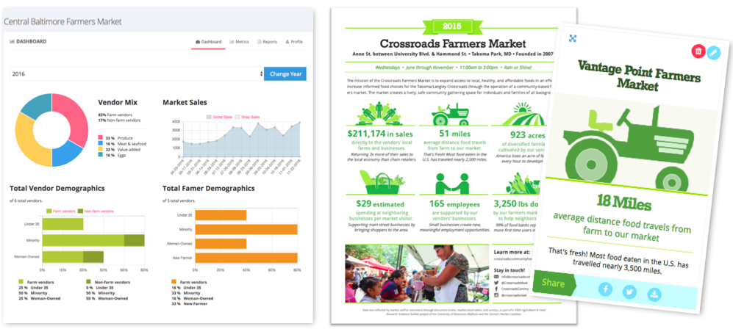
Farmersmarketmetrics.guide

Slide 21
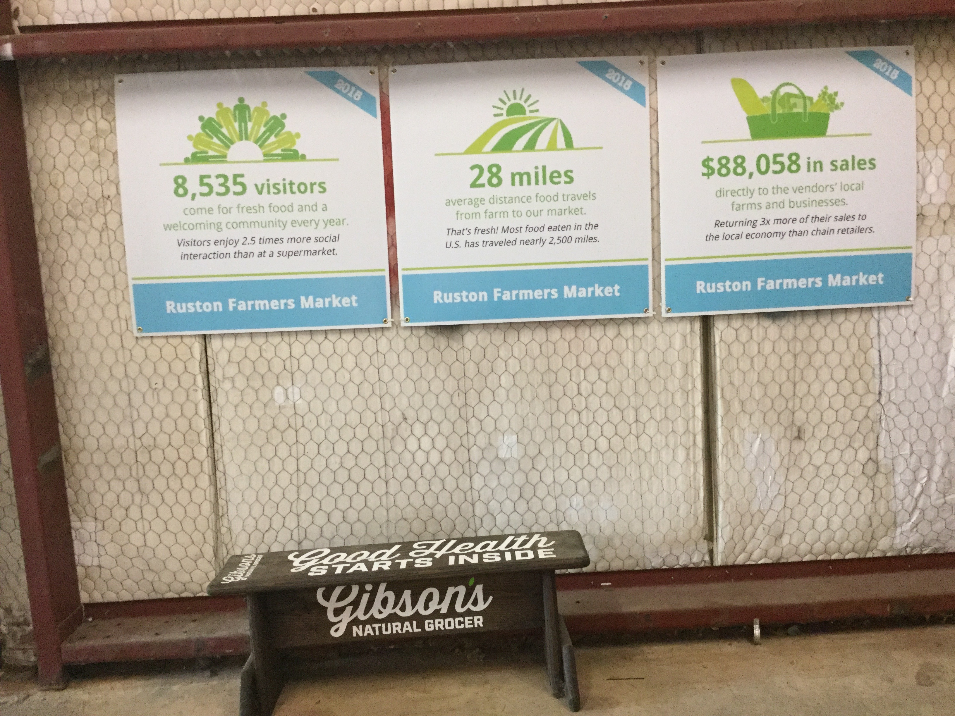
Farmersmarketmetrics.guide

Slide 22
Data matters because….
“We move from data to information to knowledge to wisdom.
Wisdom without any data is
just a hunch.”
Toni Morrison
“The Source of Self-Regard”
Notes:
I listen to people working on agricultural ideas talk about “food systems,” but I don’t know what they’re referring to. We don’t have one. There is a system that’s highly dependent on poisons and petroleum. And maybe some places have the beginnings of a small food system. But we’re not there yet.

Slide 23
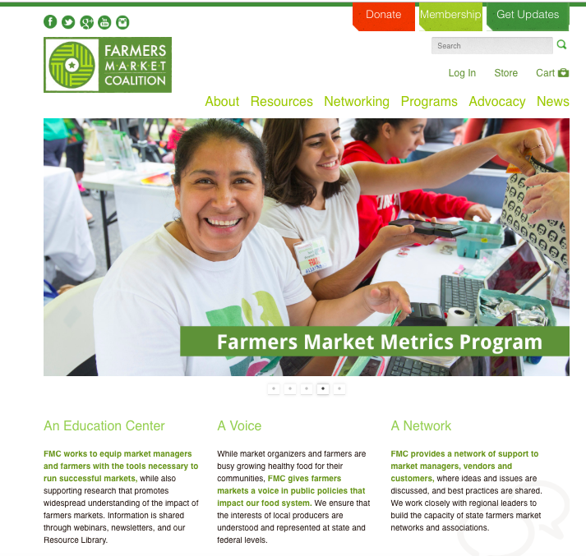
Notes:
I listen to people working on agricultural ideas talk about “food systems,” but I don’t know what they’re referring to. We don’t have one. There is a system that’s highly dependent on poisons and petroleum. And maybe some places have the beginnings of a small food system. But we’re not there yet.

